Slide 1

Financial Literacy With AI Integration
Presented by Kopparthi Lakshmi Venkata Jayaram (192210314)
CSE Department
SIMATS Engineering

Slide 2

LINKEDIN ARTICLE: Financial Literacy With AI Integration
This AI-Powered Financial Literacy App is designed to make financial education more accessible, practical, and easy to understand for everyone. Many people struggle to interpret financial concepts like investments, taxation and insurance and online information often feels overwhelming or unreliable. This app addresses that challenge by offering an intelligent AI chatbot that explains financial topics in simple language, provides personalized guidance based on user goals, and supports smarter decision-making through tools like EMI, SIP and tax calculators. Alongside the chatbot, a structured learning hub offers beginner-to-expert modules, daily financial tips, and interactive content to build strong financial foundations.
The final product delivers a clean, user-friendly experience that helps users understand money management, build disciplined financial habits, and confidently plan for their future. This project allowed me to combine AI, financial domain knowledge, and user-centered design to create a meaningful solution that empowers individuals to take control of their financial well-being.
https://www.linkedin.com/pulse/money-mentor-intelligent-financial-literacy-ai-tools-kopparthi-sybqc

Slide 3
PROJECT OVERVIEW
THE PRODUCT:
The AI-Powered Financial Literacy App is an intelligent mobile application designed to simplify financial education and help users make informed financial decisions. It combines an AI chatbot that explains financial concepts in simple language with structured learning modules, smart financial calculators (EMI, SIP, tax), goal tracking, daily financial tips and Live rates of Gold and Silver. The app provides personalized guidance based on user profiles, helping individuals improve budgeting, investing, insurance planning, and long-term wealth management. Built with a focus on clarity, security, and user-friendly design, the project aims to promote financial awareness and empower users to confidently manage their financial future.
PROJECT TIMELINE: 6 WEEKS

Slide 4
PROBLEM STATEMENT
Devi, a young working professional, often feels confused about managing his finances. When she hears terms like SIP, tax deductions, credit score, or insurance coverage, she struggles to understand whether she is making the right financial decisions. Due to overwhelming and sometimes unreliable online information, complex financial jargon, and lack of proper guidance, she feels uncertain and anxious about investments, loans, and long-term planning. Consulting a financial advisor for every small doubt is expensive and not always practical, yet ignoring financial planning can lead to poor money management and missed opportunities. Existing finance apps mostly focus on transactions or generic content and do not provide clear, personalized, and easy-to-understand financial guidance. This gap leaves users like Devi without a trustworthy and intelligent source of financial support, making it difficult for them to confidently manage their financial future.

Slide 5
PROJECT OVERVIEW
PROBLEM:
Lack of reliable and instant financial guidance for everyday money decisions.
Online financial information is overwhelming, complex, and often not personalized.
Users struggle to understand concepts like investments, taxation and insurance.
Consulting financial advisors for minor doubts is expensive and not always accessible.
GOAL:
Offer structured financial education in a simple and user-friendly mobile app.
Enable users to use smart financial tools (EMI, SIP, tax calculators) for better decision-making.
Empower individuals to manage budgeting, investments, insurance, and long-term financial goals confidently.
Provide an AI-powered chatbot that delivers clear, personalized financial guidance anytime.

Slide 6
PROJECT OVERVIEW
My Role:
Developed the app to provide users with instant, reliable financial guidance.
Designed and implemented an AI chatbot that simplifies complex financial concepts for non-experts.
Created a smooth, user-friendly experience for learning, planning, and managing personal finances.
My Responsibilities:
Understand user financial challenges and design clear, helpful features.
Build intuitive screens and AI logic for financial guidance and education.
Ensure the system remains secure, accurate, fast, and accessible for all users.
Implement financial calculation algorithms (EMI, SIP, tax).

Slide 7
GANTT CHART
Task | Week 1 | Week 2 | Week 3 | Week 4 | Week 5 | Week 6
GPCU submission & approval | ✔
UI Design Prototyping |  | ✔
UI Prototype Workflow |  |  | ✔
App UI Development |  |  |  | ✔
Backend Development |  |  |  |  | ✔
Integration of Frontend and Backend |  |  |  |  |  | ✔
Implementation and Deployment |  |  |  |  |  | ✔
Pitching their company |  |  |  |  |  | ✔

Slide 8
PROJECT TIMELINE
GPCU submission & approval
APP UI Development
Implementation and Deployment
28/02/26
23/01/26
02/02/26
06/02/26
23/02/26
Pitching their Company
19/01/26
UI Design Prototyping
UI Design Workflow
Backend Development
Integration of Frontend and Backend

Slide 9
UNDERSTANDING THE USERS
User research
Personas
Problem Statements
User Journey

Slide 10

USER PERSONA 1
Goal
Rudhra is a 26-year-old working professional who wants a simple and fast way to understand investments, budgeting, and tax-saving options. He needs an AI-driven app that explains financial concepts clearly, helps him plan his savings, and guides him toward building long-term wealth without complicated financial jargon.
Frustrations
Finds financial terms like SIP, mutual funds, and capital gains confusing
Unsure where to start with investing
Overwhelmed by too much financial content online
Afraid of making wrong investment decisions
No personalized financial guidance tailored to his income and goals
Problem Statement
Rudhra struggles to manage his finances confidently because existing resources are either too technical or too generic. He needs a clear, AI-powered system that simplifies financial concepts, provides personalized recommendations, and helps him build smart money habits step by step.
Name: Rudhra
Age: 26 years
Occupation: Software Engineer
Location: Chennai,India
Education: BE in CSE

Slide 11

USER PERSONA 2
Goal
Devi is a 32-year-old professional who wants to plan her finances efficiently while balancing family responsibilities. She needs a trustworthy platform that helps her understand insurance coverage, retirement planning, and tax optimization through easy explanations and practical financial tools.
Frustrations
Unsure how much insurance coverage she actually needs
Confused about retirement planning and long-term investments
Finds financial advice online inconsistent or sales-driven
Doesn’t have time to consult financial advisors frequently
Struggles to track financial goals and progress
Problem Statement
Devi finds it difficult to make informed financial decisions because current platforms focus on transactions rather than education and personalized guidance. She needs a reliable AI assistant that explains financial strategies clearly, provides goal-based planning tools, and supports her in securing her family’s financial future confidently.
Name: Devi
Age: 32 years
Occupation: Software Engineer
Location: Andhra Pradesh, India
Education: BTech in CSE

Slide 12
USER JOURNEY MAP
Persona: Rudhra, 27, Working Professional
Goal: Get instant, clear, and personalized financial guidance using an AI assistant that explains money concepts, suggests smart financial actions, and helps build long-term wealth confidently.
The journey of Rudhra shows how the AI-powered financial assistant helps him understand money concepts, plan finances, take smart actions, and improve financial habits confidently.
ACTION | Understand Financial Situation | Get AI-Based Guidance | Use Financial Tools | Learn Through Education Hub | Track Progress & Improve Wealth
TASK LIST | a. Ask chatbot about budgeting, investments, or tax. b. Enter income & expense details. | a. Read AI explanation in simple terms. b. View personalized suggestions & risk profile. | a. Use EMI/SIP calculator. b. Estimate Tax coverage. | a. Read short finance lessons. b. Read daily tips. | a. Check goal progress dashboard. b. Review monthly financial summary & insights.
FEELING ADJECTIVE | I feel understood and aware. | I feel informed and confident. | I feel empowered and in control. | I feel educated and financially smarter. | I feel motivated and financially secure.
IMPROVEMENT OPPORTUNITIES | Add voice-based financial queries. | Provide multilingual financial explanations. | Offer scenario simulation (e.g., “What if I invest ₹5000 monthly?”). | Add interactive mini-challenges. | Provide AI-generated weekly financial performance reports.

Slide 13
COMPETITIVE ANALYSIS

Slide 14
User Research: Summary
The user research for the AI-Powered Financial Literacy App focused on understanding how individuals struggle to access reliable, personalized, and easy-to-understand financial guidance. I analyzed common user behaviors and pain points by studying existing platforms such as finance blogs, YouTube financial educators, banking apps, investment platforms, and generic budgeting tools, observing their limitations. I also reviewed discussions from finance forums, app reviews, and Q&A platforms, which revealed that users need simplified explanations of concepts like SIP, tax deductions and EMI Calculator. Users expressed the need for personalized recommendations, risk-level indicators, goal-based planning support, and structured learning paths instead of random financial content. The research highlighted a strong demand for a trustworthy, AI-driven assistant that combines financial education, practical tools, and intelligent guidance in one easy-to-use platform, empowering users to make confident financial decisions without relying solely on expensive advisors or confusing internet searches.

Slide 15
BUSINESS POTENTIAL
GAP Evaluation Most existing financial information sources—such as Google searches, finance blogs, YouTube channels, and investment platforms—are not beginner-friendly and often overwhelm users with technical jargon, inconsistent advice, or sales-driven content. Many apps focus mainly on transactions (banking, trading, payments) rather than education and personalized financial guidance. While calculators are available, they often lack simple explanations of results or actionable next steps. Traditional financial advisory services are expensive and not accessible for everyday doubts.
The Intended Audience This application is designed for individuals seeking quick, reliable financial guidance, including students, working professionals, young earners, parents, small business owners, aspiring investors, and anyone looking to improve financial literacy. It is especially useful for people who lack access to professional financial advisors, feel confused by financial jargon, or want personalized support for budgeting, investing, tax planning, insurance coverage, and retirement planning. The app also supports users who want to build disciplined money habits and make confident long-term financial decisions.
Market Cap: The global FinTech and digital financial education market is rapidly expanding, with the AI-driven financial services sector projected to grow significantly in the coming years. The global FinTech market is expected to exceed $300 billion by 2030, with AI-based financial advisory and robo-advisory platforms becoming increasingly popular. In India alone, financial literacy remains a major challenge, with a large percentage of the population lacking structured financial education while over 750 million smartphone users rely on mobile apps for daily services.

Slide 16
COMPETITIVE ANALYSIS
First impression
Competitor | Competitor type | Location | Product offering | Price | Business size | Target Audience | Unique value proposition
Purpose | Financial literacy & education platform | India with focus on Tier-2 & Tier-3 city learners | 100+ interactive, gamified courses covering personal finance | Free | Small–Medium | Students, job seekers, beginners in finance, early working professionals | Combines structured financial literacy content with interactive tasks, vernacular language options, and real-life practical exercises to simplify learning for all age groups
Fili | Financial literacy & gamified learning | India | Short quiz & games for lessons covering budgeting, saving, investing basics | Free | Small–Medium | Teenagers, beginners | Quick bite-sized education with gamification and a community learning experience for everyday finance concepts
App / Website Experience | Observations
Clean, simple chatbot interface with quick responses | Good for basic Q&A but lacks deep personalization and structured emergency guidance.
Professional teledentistry-style UI with multiple features (chatbot, image upload, bookings) | Feature-rich but overwhelming for users who only want quick self-care guidance; focuses more on clinics.

Slide 17
COMPETITIVE ANALYSIS
Competitor | AI Guidance Quality | Accessibility | User Flow | Navigation | Tone | Content Description
Purpose | RATING: No AI chatbot; structured financial literacy courses with gamified learning | RATING: Mobile + web; focused on India (Tier-2 & Tier-3 cities) | RATING: Course-based structured flow with interactive tasks | RATING: Organized module navigation; learning-focused | Educational, structured, beginner-friendly | Provides 100+ interactive financial literacy courses with gamification, vernacular language support, and practical exercises, but lacks AI-driven personalized financial guidance
Fili | RATING: No AI personalization; quiz-based financial learning | RATING: Mobile accessible in India | RATING: Short quiz-based lessons; bite-sized engagement | RATING: Simple navigation centered around quizzes & rewards | Friendly, gamified, casual | Offers quick bite-sized financial education with points & rewards system, but limited depth, personalization, and advanced financial planning tools
Interaction
Visual Design

Slide 18
User Research: Pain Points
Confusing Online Financial Information
Users often get overwhelmed by complex financial jargon, technical terms, and contradictory advice when searching online about investments, taxes or insurance.
Scattered and Non-Structured Financial Education
Financial learning resources are often text-heavy, unengaging, and not organized in a structured path (Beginner → Advanced), making it difficult for users to apply knowledge practically.
Lack of Clear Actionable Steps
Users may use calculators (EMI, SIP, tax), but they often don’t understand what the results mean or what actions to take next, leading to confusion and inaction.

Slide 19
RAPID PROTOTYPING
FLOW DIAGRAM
Learning Center
Daily Financial Tips
Articles
Quizzes
Financial Tool
SIP Calculator
EMI Calculator
Tax Calculator
Real-Time Rates
Gold Rate
Silver Rate
Create New Account
Home Page
Application
Profile
Settings
Existing User
User Profile
Goals
History
Preferences
Chatbot

Slide 20
PROCESS DIAGRAM
EXISTING USER
FINANCIAL TOOLS
EMI CALCULATOR
SIP CALCULTOR
START
LOGIN
HOME PAGE
LEARNING CENTER
CATEGORIES PAGE
ARTICLES
DAILY TIPS
NEW USER
SETTINGS
LOG OUT
REGISTER
PROFILE
GOLD RATE & SILVER RATE
GOAL TRACKER
AI INTEGRATION
CHATBOT
The link is here.

Slide 21
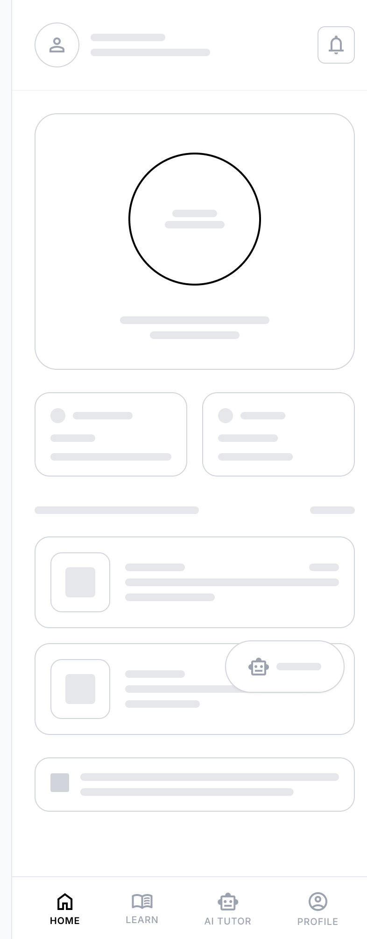
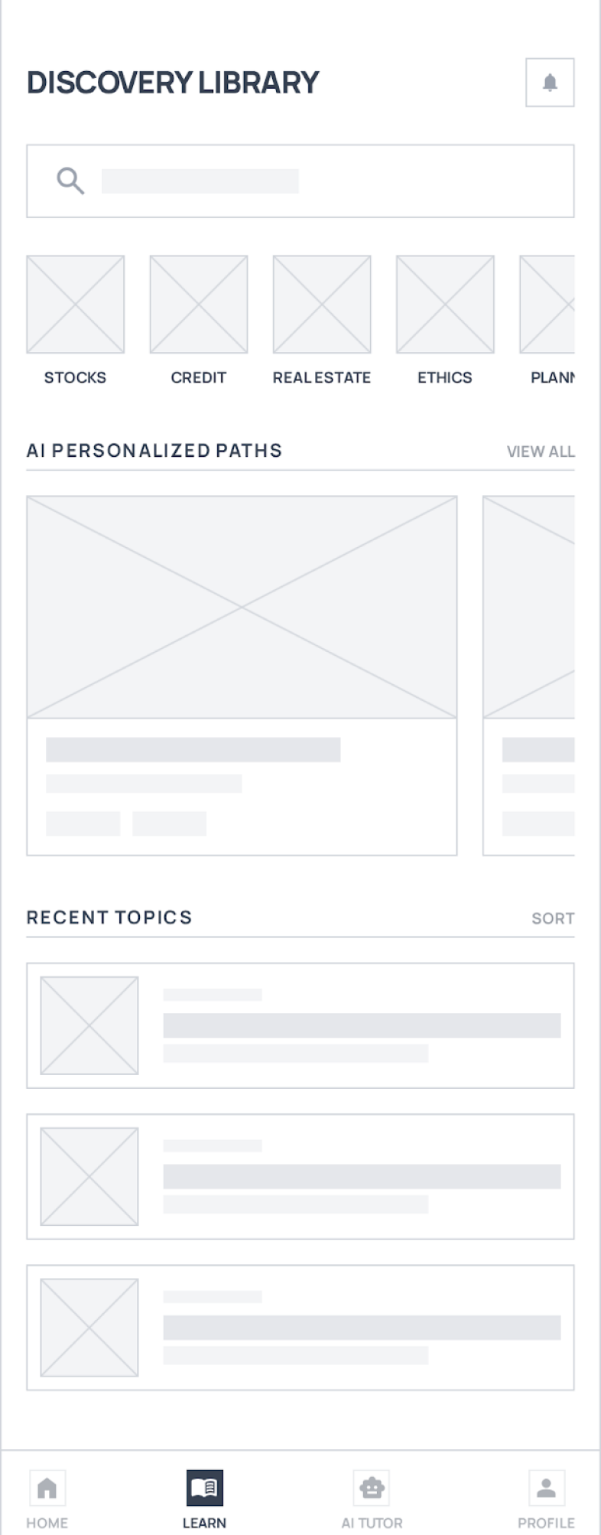
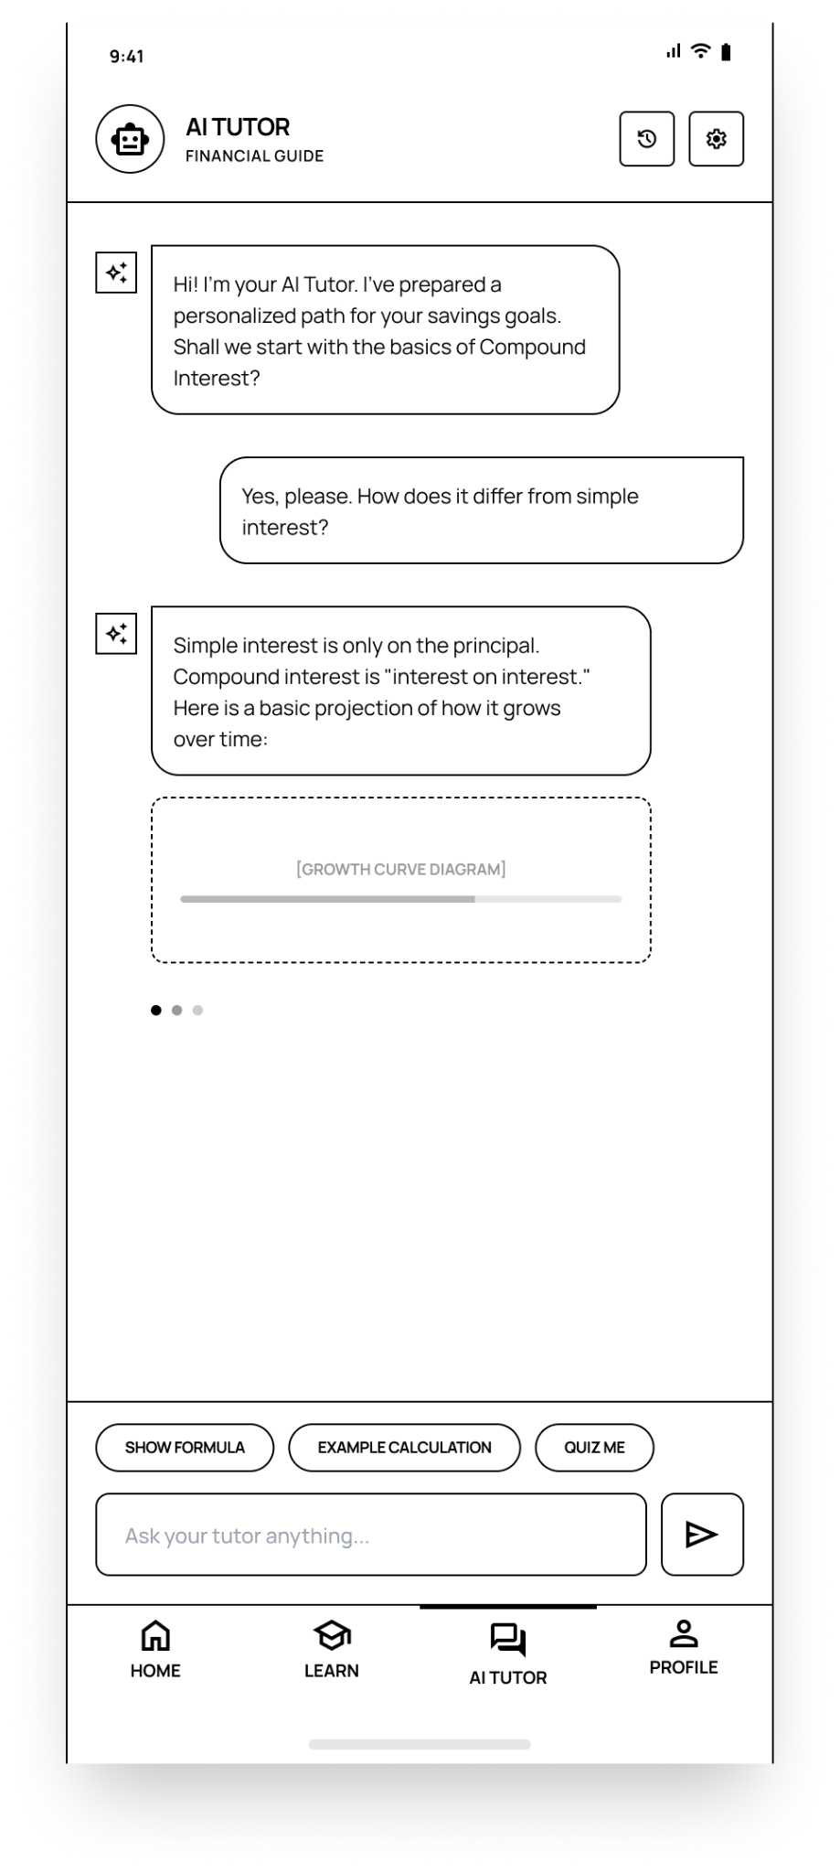
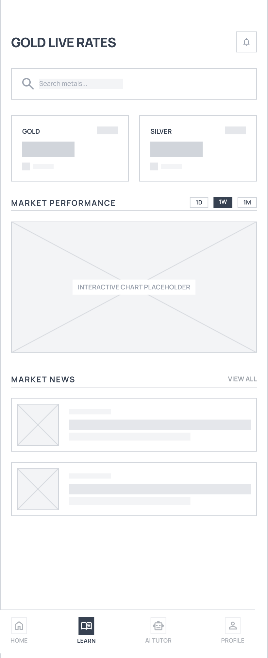
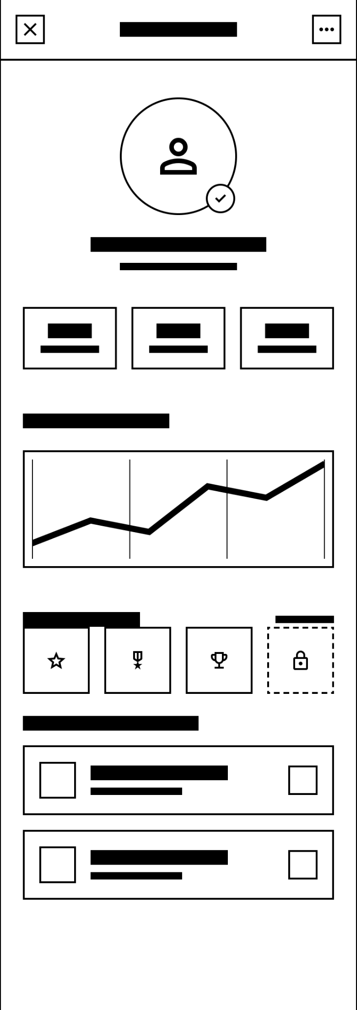
MOCKUPS LOW FIDELITY-(CONVERGENCE)

Slide 22
USABILITY STUDIES
Round 01 – Financial Guidance Clarity Issues
Early testers felt overwhelmed because the AI chatbot sometimes provided too much financial information at once.
Users struggled to identify the main actionable step—whether to invest, save more, reduce expenses, or adjust risk levels.
Mixing financial terms (e.g., CAGR, expense ratio, capital gains) with explanations on the same screen confused beginner users.
First-time users were unsure whether to focus on learning modules, tools, or chatbot suggestions.
Recommendation: Simplify the chatbot output by prioritizing the main actionable guidance first (e.g., “Recommended Action: Invest ₹5,000 monthly in SIP”), followed by expandable sections such as explanation, risk analysis, and alternative options under collapsible menus to reduce cognitive overload.
Round 02 – Feature Accessibility Improvement
After interface simplification, users requested faster access to key features such as Financial Tools, Daily Tips, and Goal Tracking.
Users wanted clearer navigation between Chatbot, Education Hub, Tools, and Financial Goals modules.
Participants preferred visual breakdowns (graphs, pie charts, progress bars) instead of long text explanations for financial results.
Some users requested quick shortcuts for commonly used calculators like EMI and SIP.
Recommendation: Add quick-access icons on the Home Dashboard for Chatbot, Tools, Goals, and Daily Tips. Include visual summaries (charts, progress bars, risk indicators) for financial results and ensure a consistent bottom navigation bar to improve usability and reduce navigation effort.

Slide 23

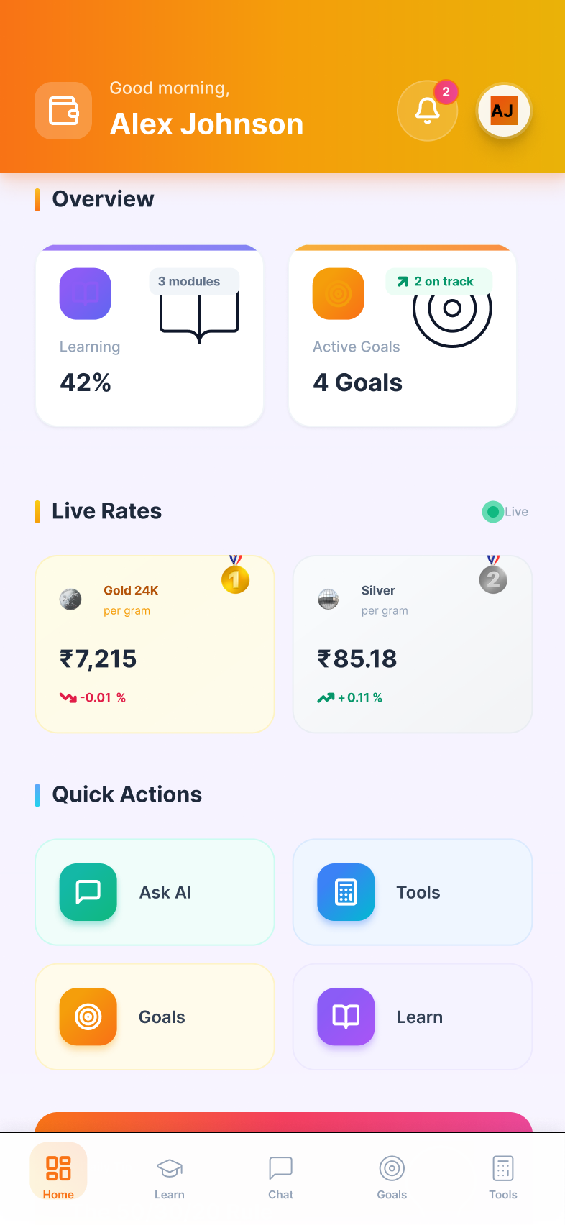
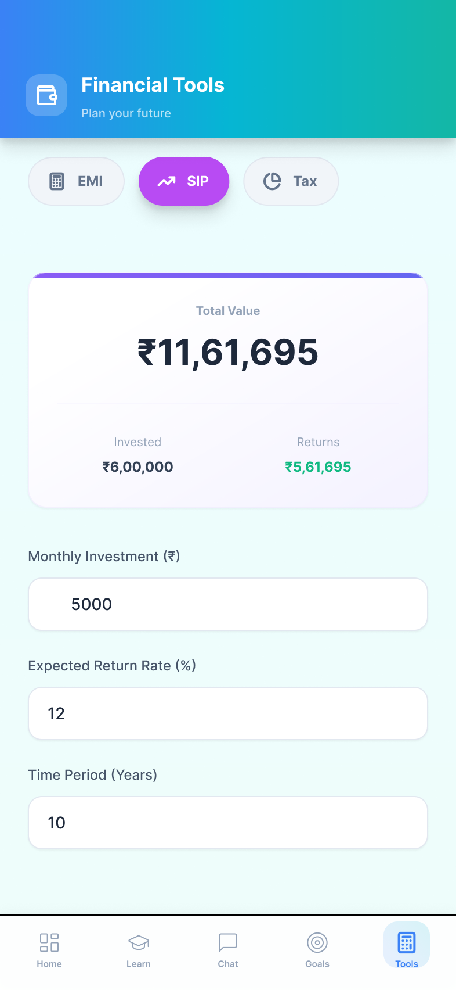
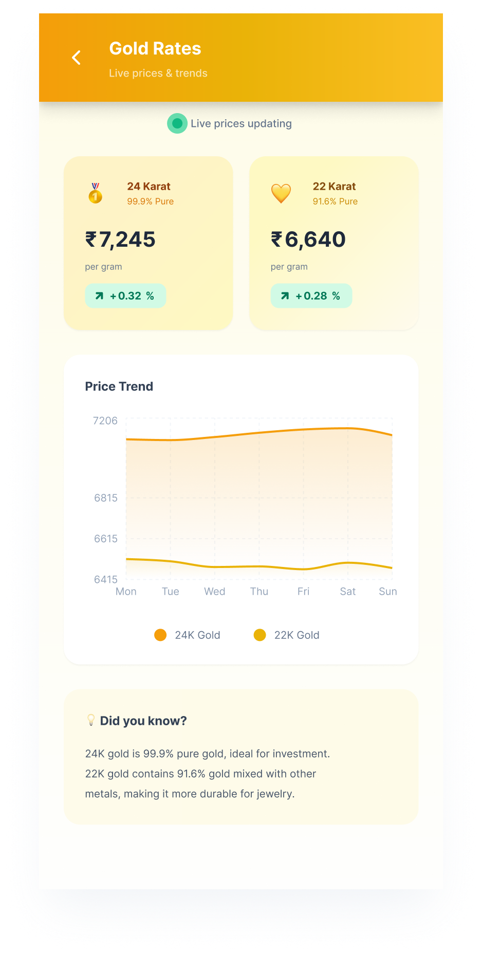
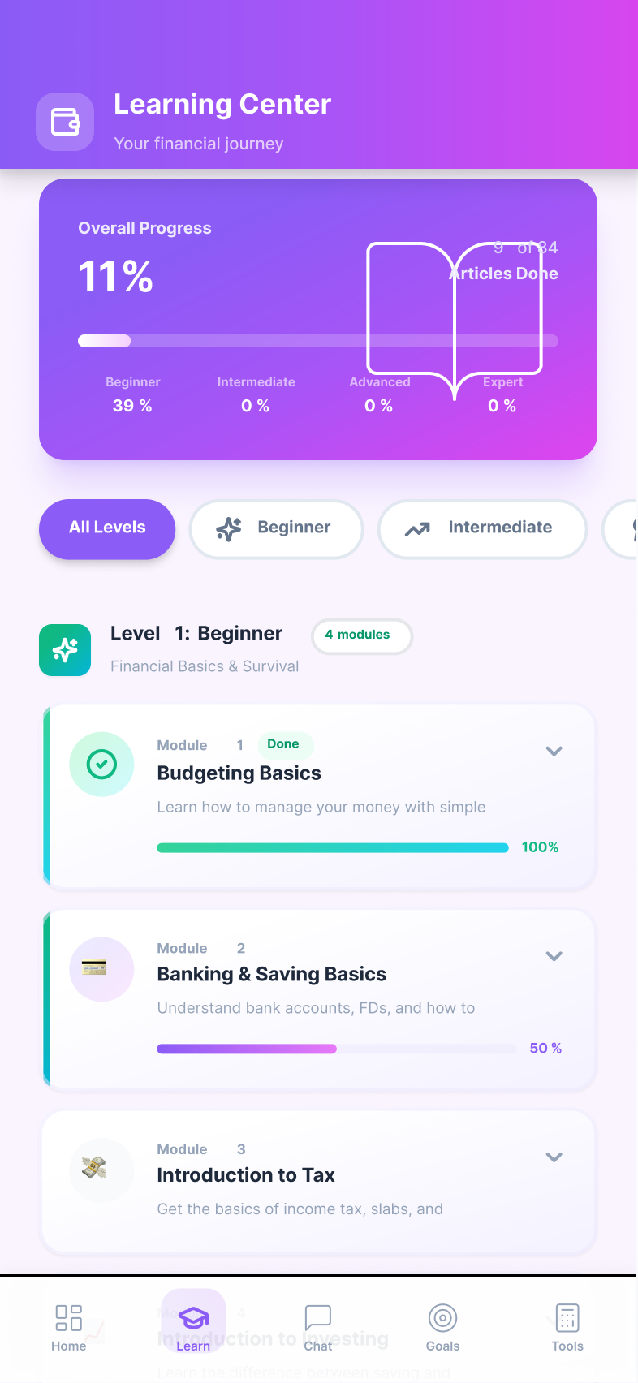
PRODUCT HI FIDELITY

Slide 24
PRODUCT DESIGN MOCKUPS
Impact of the Project:
The app’s AI-powered financial guidance helps users understand complex financial concepts instantly by providing clear explanations, risk indicators, and personalized recommendations.
With its structured learning hub, smart financial calculators, goal-tracking system, and daily tips, the app empowers students, working professionals, families, and aspiring investors to manage their finances confidently.
The combination of AI-driven advice, practical financial tools, and visual progress tracking improves financial awareness and reduces dependence on confusing or sales-driven online content.
What We Learned from the Project:
Observing how users describe their financial concerns helped refine the chatbot to deliver simpler, more conversational explanations instead of technical financial jargon.
We learned that users prefer visual summaries (charts, progress bars, risk meters) rather than long text explanations when reviewing financial results or investment projections.
Insights highlighted the importance of personalization—users are more engaged when recommendations are tailored to their income, goals, and risk appetite.

Slide 25
PRODUCT DESIGN PATENT
Unique Features:
The app uses a context-aware conversational AI system that analyzes user profile data (income, goals, risk appetite) along with real-time query input to generate personalized financial guidance.
The system integrates deterministic financial formulas (EMI, SIP, Tax) with AI-generated contextual explanations.
It clearly highlights the combination of financial education + artificial intelligence, making the app instantly stand out from traditional finance or learning apps.
Link:
https://docs.google.com/document/d/11ndGkCTz8MOhtazkRFnUpkzSW-CXxv8n/edit?usp=sharing&ouid=102391266056544561512&rtpof=true&sd=true

Slide 26
Development Stack
FRONTEND
Platform: Android (Kotlin)
Web Application: Bootstrap (HTML, CSS and JS)
UI Design: Figma
Framework: Android Studio with XML layouts + RecyclerView, Adapters, Activities/Fragments
Purpose: Provides an interactive mobile interface for financial education, expense tracking, and personalized insights.
BACKEND
Language: Python
Framework: Flask (REST API)
Server: Apache (XAMPP) during development
Functionality:
Handles user authentication & sessions
Manages financial learning progress
Processes chatbot responses
Fetches gold/silver price data
Sends push notifications
Handles API requests from Android app
Generates financial insights
DATABASE
Type: MySQL
Name: elearning_db
Backend + Database:
Python Flask APIs perform CRUD operations
Users, Learning progress, Financial data, Notifications, User activity logs
Frontend + Backend:
Communication via REST API (HTTP requests)
Android app sends requests via Retrofit.
Backend returns JSON responses

Slide 27
Key ISO Codes for Compliance:
ISO/IEC 27001 – Secures user data and protects stored startup architecture information.
ISO/IEC 27701 – Ensures privacy management for user inputs, chat interactions, and saved project documents.
ISO/IEC 25010 – Maintains high software quality for reliable and usable AI-generated LLD outputs.
ISO 9241-210 – Guides human-centered UI design for non-technical founders using the Q&A workflow.
ISO/IEC 29147 – Allows safe and structured reporting of vulnerabilities within the app’s AI chatbot, financial calculators, backend systems, and data storage.
WCAG 2.2 (W3C) – Ensures visual clarity, voice interaction support, readable font sizes, and compatibility with assistive technologies.
Step A: Core AI Financial Guidance Functionality
Provide instant AI-powered financial explanations with clear concept breakdown (e.g., SIP, EMI, tax, insurance), risk indicators, and recommended actionable steps.
Support chat-based interactions that allow users to ask follow-up financial questions without navigating multiple menus.
Maintain user financial history, calculations, goals, and recommendations, allowing users to revisit and track their financial progress over time.
Step B: AI Intelligence & Personalization Features
Use AI to deliver context-aware financial guidance, adapting responses based on income level, risk profile instead of generic advice.
Generate simple explanations that convert complex financial terminology into easy, everyday language with clear next steps.
Suggest relevant tools and learning modules, such as EMI calculators, retirement planners, investment lessons, and goal tracking based on the user’s financial situation and queries.

Slide 28
Thank You
Gmail: jayaramklv@gmail.com
Mobile no: 7093262577

